Slide 1

Smart contact lenses for the modern world
Stéphane Díaz-Alejo León - Ignacio Loyola Delgado - Jorge Fernández Alfonso - Joan Colom Colom

Slide 2
0. Index.
The problem
Our company
Analysis
External analysis
Internal analysis
Summary
Our strategy

Slide 3
The problem

Slide 4
“When you have traveled to as many countries as I have (over 60), you can’t help but have a few funny stories related to language barriers. Getting on the wrong bus, ordering something horrific or insulting someone you wanted to praise”
Roxanne Genier

Slide 5
Languages have divided humanity into tribes since millenia. We believe an understanding of them can make the world a better place.

Slide 6
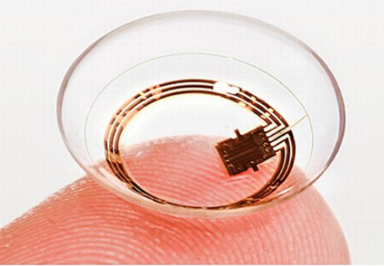
Our solution

Slide 7
Minimalist style.
Capacity of reading in every language.
Easy to put them.
Gradually graduated contact lenses.
Comfortable.
Difficult to note them.
Different colours.
Monitoring of health condition (Can detect a glaucoma, diabetes…).
Records what you see in the cloud.
Access control and security.
Capacity of reading the soulish state of the people.
Shows a brew summary of public data of people.
Augmented reality.
GPS Navigation.
Can help workers in their job

Slide 8
2. OUR COMPANY.

Slide 9

THE MISSION AND THE VISION
Our mission is to make available this technology to the greatest possible number of people so as to make the world a better, more connected place.
Our vision is that in future we want to be one of the most important and helpful enterprises in the world, been able to make more easy the life of the people of ALL the world with our products.

Slide 10

OUR VALUES
Transparency.
100% Privacity for the users.
Guarantee the security of our products.
Compromise of facing all the possible problems generated by our products.
Environmental clean.
Social responsibility.

Slide 11
3. ANALYSIS
External and internal analysis

Slide 12
3.1. EXTERNAL ANALYSIS

Slide 13
PESTEL ANALYSIS

Slide 14

POLITICAL
Political instability (threat)
Globalization (opportunity)
Stable political climate in most of the major markets (opportunity)
Problems with overly regulating regions like China and India. (threat)

Slide 15

TECHNOLOGICAL
Growing Internet access in developing countries (opportunity)
Rapid adoption of technological devices in the global market (opportunity)
Workers with a technological profile (opportunity)

Slide 16

ECONOMICAL
Economic stability of most major markets (opportunity)
Rapid growth of developing countries (opportunity)
Fluctuation rates of dollar (threat)

Slide 17

ECOLOGICAL
Global spread of environmentalism (opportunity)
Growing interest in sustainable business (opportunity)

Slide 18

SOCIAL
Increasing use of social media (opportunity)
Rising diversity of users (opportunity)

Slide 19

LEGAL
More regulations on online privacy (opportunity)
More regulations on intellectual property rights, which would make our idea harder to copy (opportunity)

Slide 20
5 FORCES OF PORTER

Slide 21
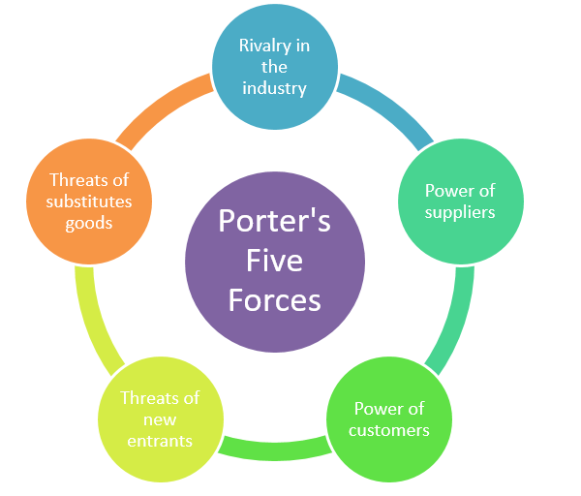
ANALYSIS OF PORTER
Competitors: As we have the patents of the product, there is not going to be rivalry in the future, furthermore, there are high requirements of capital to establish.
Providers: There are a huge number of providers and has a small cost for changing from one to other.
Substitutes: There are not substitutes of our product till the moment
Clients: All the world, so as there are too many clients from different parts of the world their power against us is small
Sector: It’s our monopoly, so there are not relevant competitors

Slide 22

3.2. Internal analysis.
Primary activities:
Internal logistics: We are not enough efficient so we had to resort to extern help.
External logistics: We are not enough efficient so we had to resort to extern help.
Commercialization: The greater part of our company are engineers, so our commercialization is not good enough.
Marketing: We have studied the marketing department of Apple and we don’t lack experts in this theme.
Post-sales services: We face and compense any problem generated by our product.

Slide 23

3.2. Internal analysis.
Support activities:
Provisioning: We have some idea of provisioning so we can defend ourselves.
Developing: Our company focus its attention on developing new products or/and upgrading the ones already created, so we have an incredible department of I+D.
Administration: As in our company we are mainly ingenieurs, the administration it is a bit pour.
Infrastructure: We have a great infrastructure built to support our workers and for maximize the efficiency.

Slide 24
3.3. Summarize.
 | Helpful | Harmful
Internal | Global extension. Client fidelization. Environmentally friendly. Great customer service. Imprescindible technology for certain sectors. Providers. | Dependency on local privacy regulations. Lack of a technology as good as contact lenses for ears. Developing countries.
External | Acquisition of potential competitors and companies that have technologies that are compatible. Development of technologies that make our main product indispensable. | A new technology can substitute our main product. Companies form an alliance in order to break the high capital requirement barrier and find a way to develop a similar technology that does not need our patents. People with high concern about privacy may mobilize against ubiquitous cameras.

Slide 25
4. CORPORATE STRATEGIES

Slide 26

THE CLUE IS DIFFERENTIATION
Taking into account the previous analysis, the more convenient strategy to develop is a strategy of differentiation to fight against knockoffs in not-so-regulated markets like China. In this way, we have a very loyal sector of clients that trust in us thanks to our product and our post-sales services. So in this way, we pretend penetrate in the market more and more, as a respected company by the users.

Slide 27
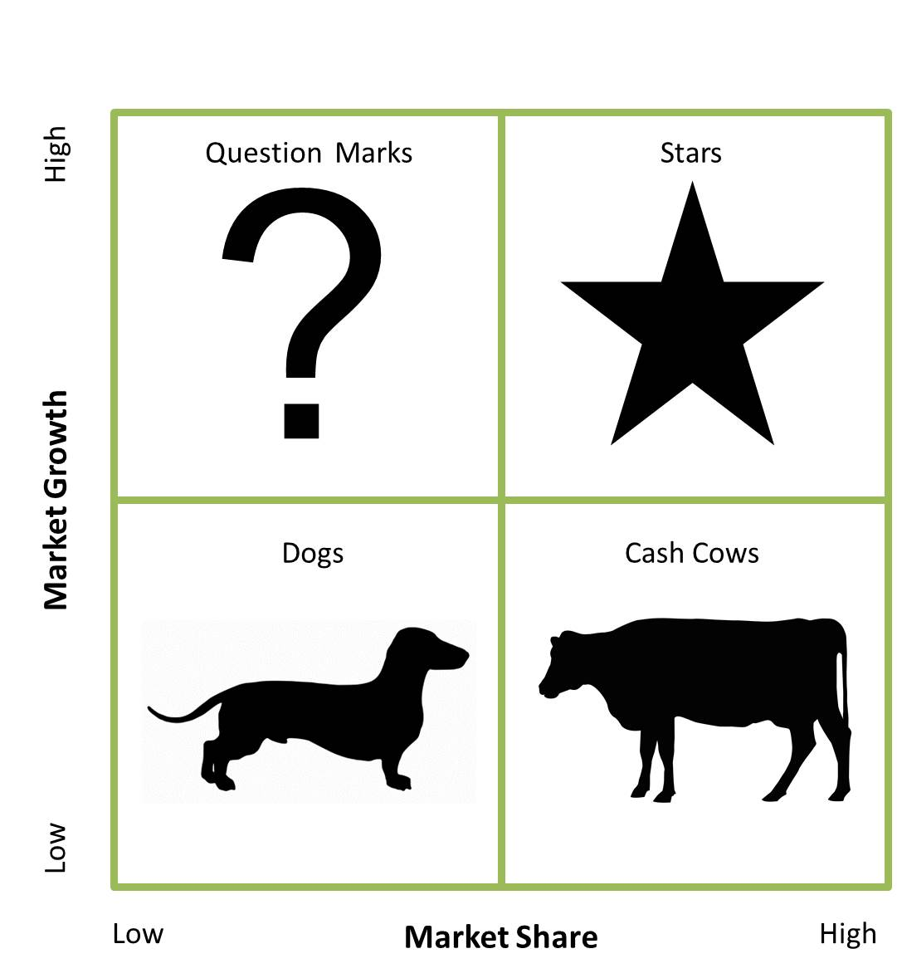
OUR STAR
As we can see our product presents an extremely high scalability potential and it would give us the lead of the maket share (first of its kind; first mover advantage), which is why we can position ourselves as a star in the BCG matrix.

Slide 28
Thank you for your attention

